Slide 1
MSE 311: Thermodynamics of Materials
期中考试
知识点梳理

Slide 2
Laws of Thermodynamics
Zeroth Law of thermodynamics:
If two systems are each in thermal equilibrium with a third, they are also in thermal equilibrium with each other.
First Law of thermodynamics
The internal energy of an isolated system is constant
Second Law of thermodynamics
Heat cannot spontaneously flow from a colder location to a hotter location
Third Law of thermodynamics
As a system approaches absolute zero, all processes cease and the entropy of the system approaches a minimum value

Slide 3

1. Temperature and Scale
Chapter1：
热力学，王竹溪，北京大学出版社

Slide 4
The definition of Temperature
<Temperature>
The quantification of the degree of the cold and hot?
<温度>
冷热程度的数值表述

Slide 5
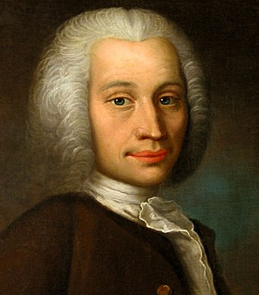
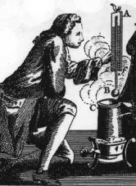
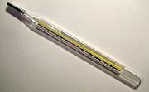
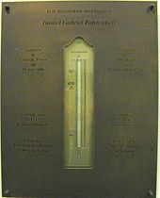
Thermometer
Celsius scale
Numerically describe the degreed of the cold and hot:
0° for the freezing point of water
100° for the boiling point of water
Anders Celsius
Swedish astronomer
(1701–1744)
Celsius was known until 1948 as centigrade
The first proposed ~1742.
Fahrenheit Scale
Proposed Mercury as a thermometric fluid.
32 °F for the freezing point of water
96 °F , as it placed in the arm or in the mouth
Memorial plaque at Fahrenheit's burial site
in the Hague
Daniel G. Fahrenheit
Dutch Physicist
(1701-1736)

Slide 6
2. Heat and Energy Conservation
Chapter 2
Introduction to the thermodynamics of materials,
5th or 6th edition, by David R. Gaskell, Taylor & Francis Press, 2018

Slide 7
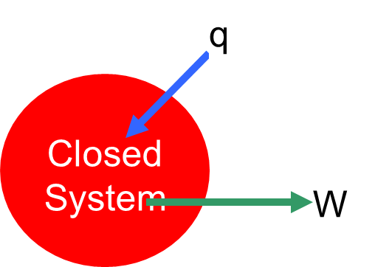
Heat and Work
Heat (q): energy exchange due to temperature difference.
q is positive when heat flows into the system
q is negative when heat flows out the system
Work (w): energy exchange due to other driving forces.
Work done by the system to the surroundings is positive
Work done by the surroundings to the system is negative
Mechanical work: due to volume change
Both heat and work are process variables, they disappear when process finishes.

Slide 8
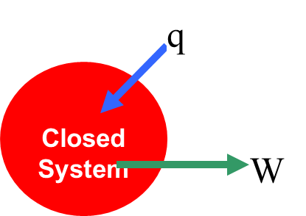
Energy conservation law
Quiz 1：2
First Law of thermodynamics is also called as The energy conservation law
For an infinitesimal change: dU = δq – δW
d ➔ a differential element of a state function
δ ➔ a differential element of a non-state function
U is the state function, independent on process
While, both q and w depend on process
So, for cyclic process (the system come back to the initial state after the process):
And

Slide 9
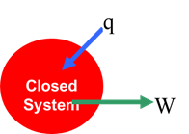
Comparison
Constant Volume Proc.
w=0, q=ΔU
w=P(V₂-V₁),
q – P(V₂ – V₁)=ΔU
Constant Press Proc.
Reversible Adiabatic Proc.
Reversible Isothermal Proc.
The amount of work generated from the heat highly depends on the process
What’s the nature of the process involving the transfer from heat to work?

Slide 10
Homework 1：5
Ten moles of ideal gas, in the initial state P₁ = 10 atm, T₁ = 300 K, are taken round the following cycle:
a. A reversible change of state along a straight line path on the P-V diagram to the state P = 1 atm, T = 300 K,
b. A reversible isobaric compression to V = 24.6 liters, and
c. A reversible constant volume process to P = 10 atm.
How much work is done on or by the system during the cycle? Is this work done on the system or by the system?

Slide 11
Polytropic process
Constant Volume Process, V= const.
Constant Pressure Process, P=const.
Reversible Adiabatic Process, δq=const.
Reversible Isothermal Process, δT=const.
P
$$PV^{n}=C\text{,}\left\{\begin{matrix}n=∞,const V \\ n=0,const P \\ n=1,const \text{T} \\ \text{n}\text{=}γ\text{, }\text{const} \text{S}\end{matrix}\right.$$
Quiz 1：4
V

Slide 12
3. Latent heat and Specific heat
Chapter 1
热力学，王竹溪，北京大学出版社
Chapter 2.6
Introduction to the thermodynamics of materials,
6th edition, by David R. Gaskell, Talor & Francis Press, 2018

Slide 13
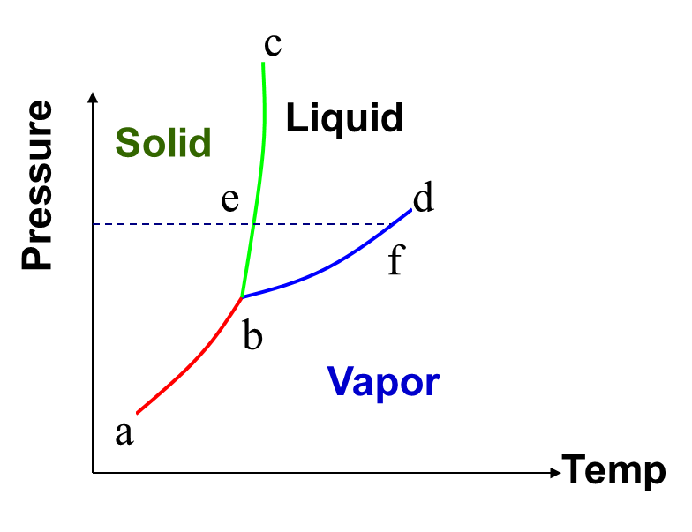
Heat Capacity
Heat Capacity (C): The ratio of heat transferred between the system and the surrounding divided by the resulted change in temperature of the system
Specific Heat Capacity (c): heat capacity / mole
Heat transferred
Temperature change
A Material Property?
Process Dependence?
Phase Transition

Slide 14
Heat Capacity: C_{V} and C_{P}
Quiz 1：5
Is dU=C_{v}dT always true? If not, please state the condition of invalidity.
No. For nonideal gas.
Constant Volume Process (C_{V}):
dU = δq – δW = δq
or dU=C_{v}dT
Constant Pressure Process (C_{P}):
dH =dU+pdV= δq
or dH=C_{P}dT

Slide 15
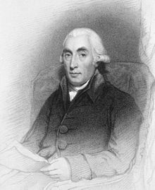
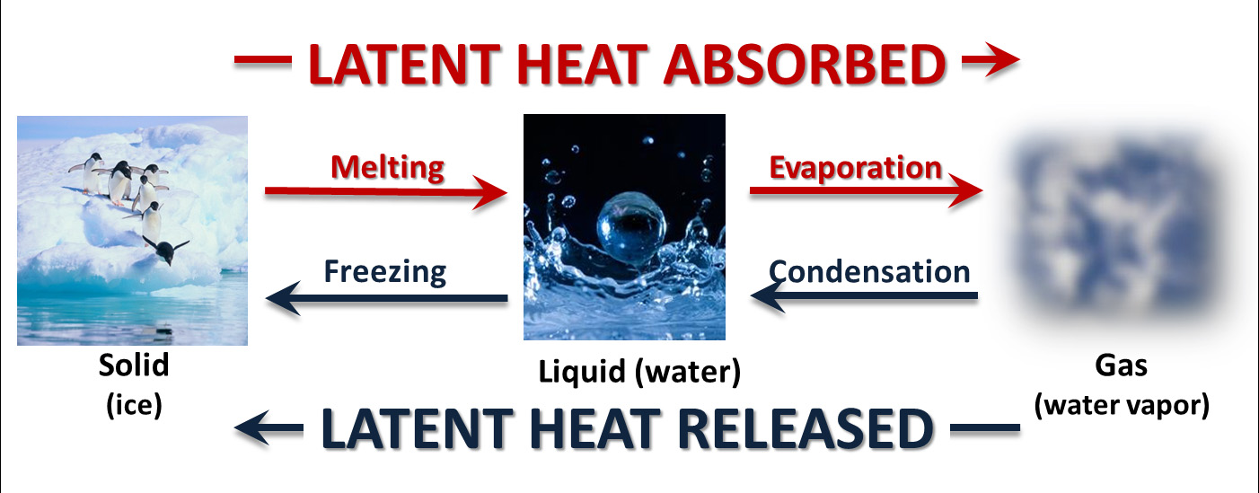
Latent heat
Joseph Black
Scottish physicist
(1728 –1799)
energy released or absorbed,
by a body or a thermodynamic system,
during a constant-temperature process,
usually a first-order phase transition.

Slide 16
4. The measurement of C_{v}

Slide 17
The relation between C_{V} and C_{P}
Represents the work done by the system per degree rise in temperature in expanding against the constant external pressure P acting on the system
Represents the work done by the system per degree rise in temperature in expanding against the internal cohesive forces acting between the constituent particles of the substance

Slide 18
The relation between C_{V} and C_{P}
Joule concluded that the internal energy of a gas (ideal) is a function of temperature only.
For idea gas:
For liquid or solid
For ideal gas:
Quiz 1：3

Slide 19
5. Carnot Efficiency
Chapter 3
Introduction to the thermodynamics of materials,
5th or 6th edition, by David R. Gaskell, Talor & Francis Press, 2018

Slide 20
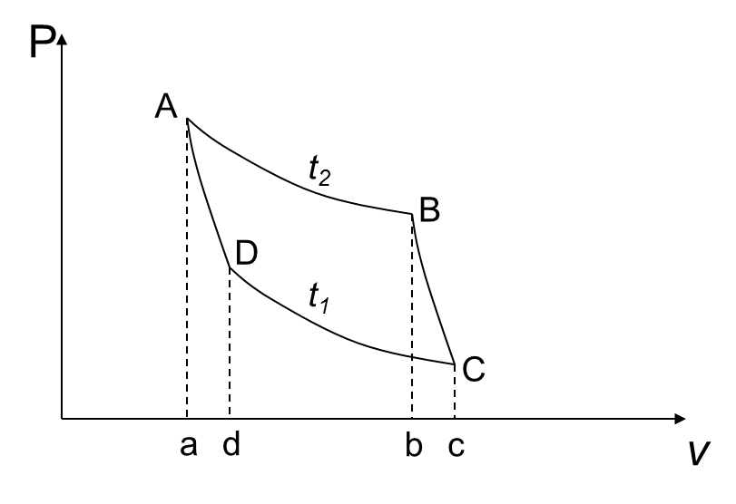
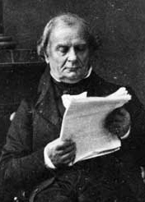
Carnot cycles in Clapeyron graph
Benoît Clapeyron
1799-1864
French
A-B: Reversible isothermal expansion.
B-C: Reversible Adiabatic expansion.
C-D: Reversible isothermal compression.
D-A: Reversible adiabatic compression.
one of the founders of thermodynamics
Quiz 2：1

Slide 21
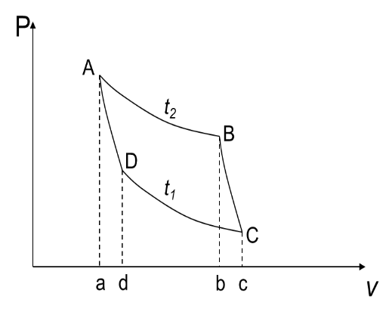
Properties of Heat Engine
One mole ideal gas.

Slide 22
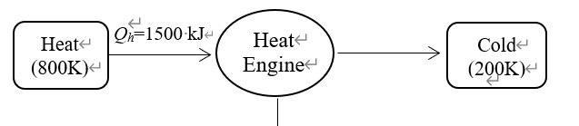
Quiz 2：2
A Carnot heat engine receives 650 kJ of heat from a source of unknown temperature and rejects 250 kJ of it to a sink at 24°C. Determine (a) the temperature of the source and (b) the thermal efficiency of the heat engine.
Quiz 2：4
Considering the following heat engine as a system, system efficiency is about 60% of Carnot efficiency under the same temperature. Please calculate the total entropy generation in this system.

Slide 23
7. Entropy
Chapter 3
Introduction to the thermodynamics of materials,
5th or 6th edition, by David R. Gaskell, Talor & Francis Press, 2018

Slide 24
Why we need the concept of entropy?
Irreversible Processes
A system left to itself will do one of two things:
it may remain in the state in which it happens to be
it may change of its own accord to some other state
Natural/Spontaneous Processes
If a system is not initially at equilibrium,
it will tend to move towards its equilibrium state
Entropy, the quantification of the Irreversible Processes

Slide 25
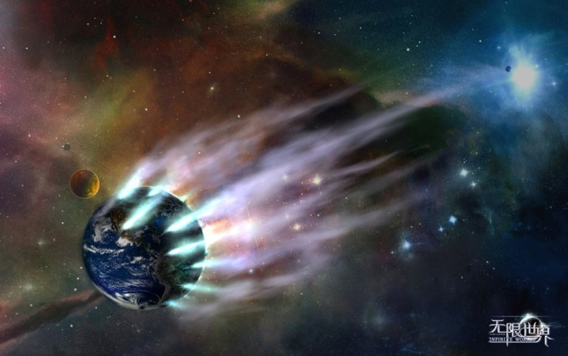
The mathematic form of 2nd law of TD
For close system subjected to spontaneous processes, it will have the change of entropy large or equal to zero
Quiz 2：3
Time is asymmetry !
The beginning of the world should be perfect!
The world might be end up with mess if without “God”!

Slide 26
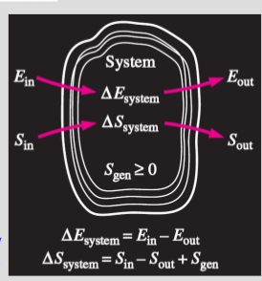
Entropy balance
Increase entropy for any system
Total
Entropy
entering
Total
Entropy
out
Total
Entropy
generation
Changing in the
Total entropy
Of the system
Considering heat engine as system
Source
（800K）
Source
（800K）
Q_{source} =2000 kJ
Q_{source} =2000 kJ
Heat engine
W= 750 kJ
Heat engine
W= 600 kJ
Q_{sink} =1250 kJ
Q_{sink} =1400 kJ
Sink
(500 K)
Sink
(500 K)
Energy and entropy balance for system

Slide 27
Entropy generated associated with heat transfer
(a) The entropy change of the subsystem Iron
System= lake + iron
Iron is cooling at constant volume condition
Lake
T₂=285K
Iron
m= 50 kg
T₁= 500K
(b) The entropy change of the subsystem lake
Both the water and the iron are incompressible
The temperature of the lake is const.
The energy it receive:
Iron：c_{avg} = 0.45 kJ/kg·K
The entropy of lake:
The generation of entropy:
Where the location of the entropy generated ?

Slide 28
The changes of entropy
1st TdS, considering T and V as independent variable
2nd TdS, considering T and P as independent variable
Notes:
Introduction of Thermodynamics of materials, D. R. Gaskell, CRC Press, chapter 5, section 5.10

Slide 29
8. Exergy and Quality of Energy
Ref. Thermodynamics: A Engineering approach, Chapter 8

Slide 30
Quality of Energy
1st law of TD: quantity of energy → energy cannot be created or destroyed.
2nd law of TD: quality of energy → degradation of energy: entropy increase / lost opportunities to do work → energy has quality as well as quantity.
Exergy (可用能): the maximum useful work that can be obtained from the system at a given state in a specified environment.
The availability of energy !

Slide 31
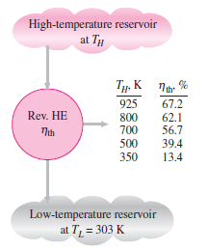
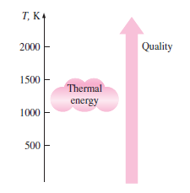
Quality of Energy
More of the high-temperature thermal energy can be converted to work → The higher the temperature, the higher the quality of energy.
mechanical energy is a more valuable form of energy (higher quality) than thermal energy，because work can be converted to heat with efficiency100%.
Electricity/electrical energy has higher quality than heat and in most times higher than work also.

Slide 32
9. Otto cycle and Diesel cycle
Ref. Thermodynamics: A Engineering approach, Chapter 9

Slide 33
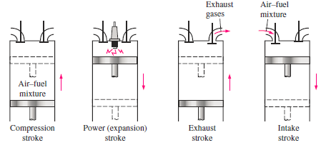
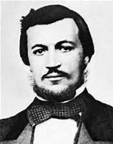
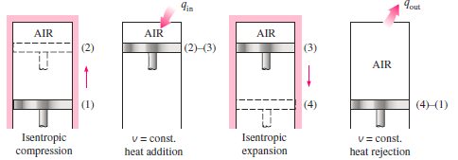
Otto Cycle
——Spark-Ignition (SI) Engine
Otto cycle:
after Nikolaus A. Otto
MSE 5006 | 33

Slide 34
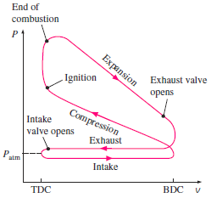
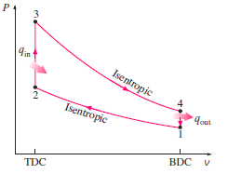
Otto Cycle
——Spark-Ignition Engine
Simplification

Slide 35
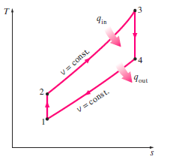



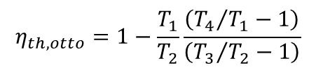
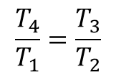
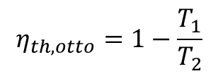
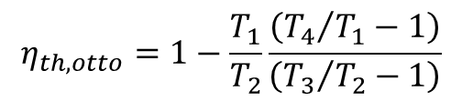
Otto Cycle
—— Spark-Ignition Engine
Isentropic, and v₂=v₃ and v₄=v₁
$$\frac{T_{4}}{T_{1}}=\frac{T_{3}}{T_{2}}$$
$$η_{th,otto}=1−\frac{T_{1}}{T_{2}}\frac{\left({T_{4}}/{T_{1}}−1\right)}{\left({T_{3}}/{T_{2}}−1\right)}$$
$$η_{th,otto}=1−\frac{T_{1}}{T_{2}}$$
$$η_{th,otto}=1−\frac{T_{1}}{T_{2}}\frac{\left({T_{4}}/{T_{1}}−1\right)}{\left({T_{3}}/{T_{2}}−1\right)}$$

Slide 36
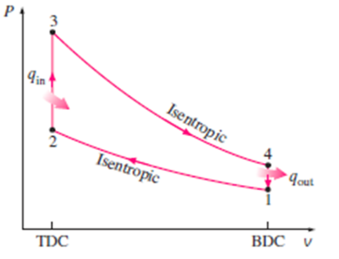
Quiz 3：4
The compression ratio of an air-standard Otto cycle is 9.5. Prior to the isentropic compression process, the air is at 100 kPa, 35°C, and 600 cm³. The temperature at the end of the isentropic expansion process is 800 K. Using specific heat values (C_{p}=1 kJ/kg, C_{v}=0.718 kJ/kg) at room temperature (T_{a}=300 K), determine (a) the highest temperature and pressure in the cycle; (b) the thermal efficiency.

Slide 37
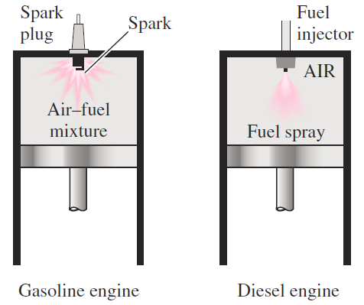
Diesel Cycle
——Combustion-Ignition (CI) Engine
After Rudolph Diesel

Slide 38
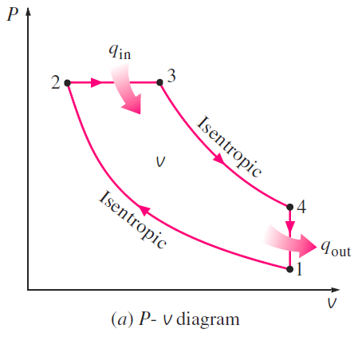
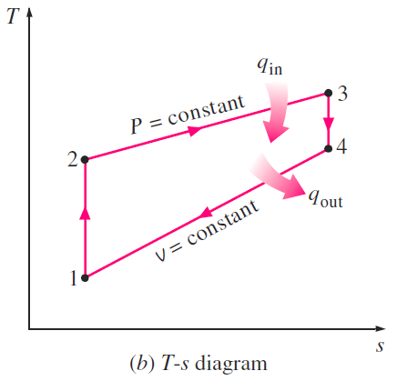


Diesel Cycle
——Combustion-Ignition Engine
Diesel cycle
Diesel cycle
1-2: Isentropic compression;
2-3: Constant-pressure heat addition;
3-4: Isentropic expansion;
4-1: Constant-volume heat rejection
Otto cycle

Slide 39



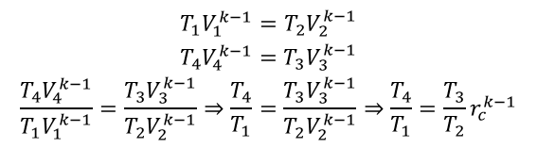
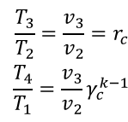
Diesel Cycle
——Combustion-Ignition Engine
Considering isentropic 1→2 and 3→ 4
Considering const P from 2→ 3
$$\begin{matrix}T_{1}V_{1}^{k−1}=T_{2}V_{2}^{k−1} \\ T_{4}V_{4}^{k−1}=T_{3}V_{3}^{k−1} \\ \frac{T_{4}V_{4}^{k−1}}{T_{1}V_{1}^{k−1}}=\frac{T_{3}V_{3}^{k−1}}{T_{2}V_{2}^{k−1}}⇒\frac{T_{4}}{T_{1}}=\frac{T_{3}V_{3}^{k−1}}{T_{2}V_{2}^{k−1}}⇒\frac{T_{4}}{T_{1}}=\frac{T_{3}}{T_{2}}r_{c}^{k−1}\end{matrix}$$
$$\begin{matrix}\frac{T_{3}}{T_{2}}=\frac{v_{3}}{v_{2}}=r_{c} \\ \frac{T_{4}}{T_{1}}=\frac{v_{3}}{v_{2}}γ_{c}^{k−1}\end{matrix}$$
Cutoff ratio r_{c}

Slide 40
10. Brayton Cycle
Ref. Thermodynamics: A Engineering approach, Chapter 9,17

Slide 41
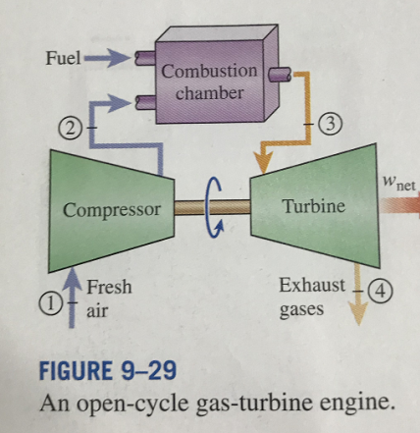
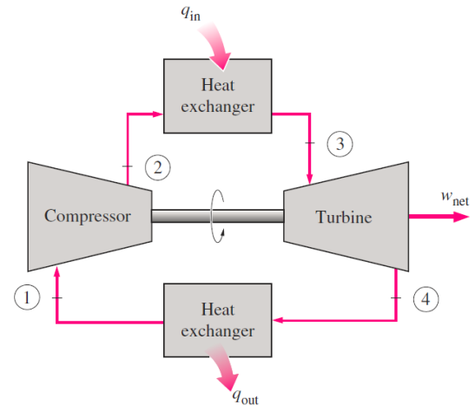
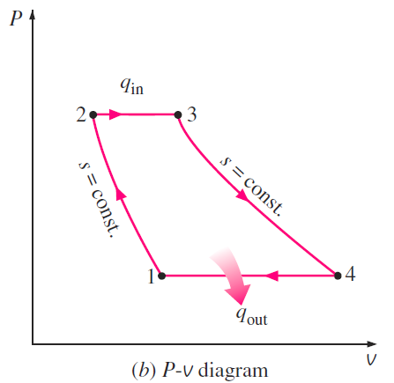
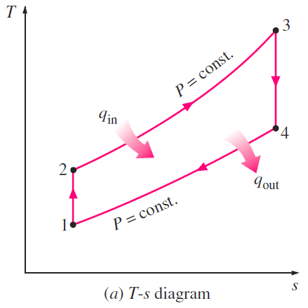

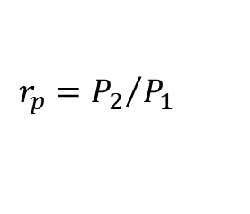
Brayton Cycle
Brayton Cycle
1→2: isentropic compression
2→3: const. pressure
3→4: isentropic expansion
4→1: const press (heat reject)
Pressure ratio
$$r_{p}={P_{2}}/{P_{1}}$$

Slide 42
11. Rankine Cycle
Ref. Thermodynamics: A Engineering approach, Chapter 3，10

Slide 43


Rankine Cycle
Notes:
Figure 10-2

Slide 44
EXAMPLE: The Simple Ideal Rankine Cycle
Consider a steam power plant operating on the simple ideal Rankine cycle.Steam enters the turbine at 3 MPa and 3508C and is condensed in the condenser at a pressure of 75 kPa. Determine the thermal efficiency of this cycle.
SOLUTION A steam power plant operating on the simple ideal Rankine cycle is considered. The thermal efficiency of the cycle is to be determined.
Assumptions 1 Steady operating conditions exist. 2 Kinetic and potential energy changes are negligible.
Analysis
The schematic of the power plant and the T-s diagram of the cycle are shown in Fig. 10–3.
We note that the power plant operates on the ideal Rankine cycle. Therefore, the pump and the turbine are isentropic, there are no pressure drops in the boiler and condenser, and steam leaves the condenser and enters the pump as saturated liquid at the condenser pressure.

Slide 46
12. Refrigeration Cycles
Ref. Thermodynamics: A Engineering approach, Chapter 10

Slide 47
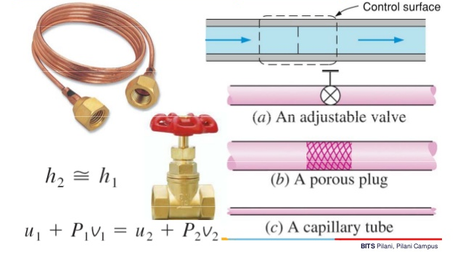
Nozzles and Throttling valve
Energy balance of the steady-flow system
Enthalpy
Internal
energy
Flow
energy

Slide 48
Joule-Thomson effect
The temperature change of a real gas or liquid (as differentiated from an ideal gas) when it is forced through a valve or porous plug while keeping it insulated so that no heat is exchanged with the environment.
μ_{J} >0 temperature decrease after throttling
μ_{J} =0 temperature no-change after throttling
μ_{J} <0 temperature increase after throttling

Slide 49
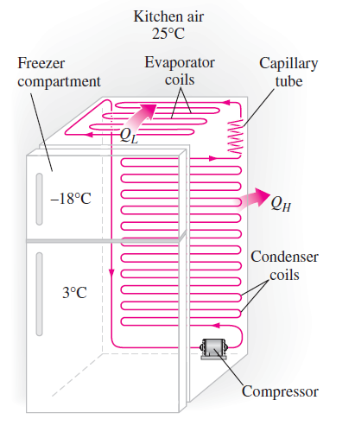
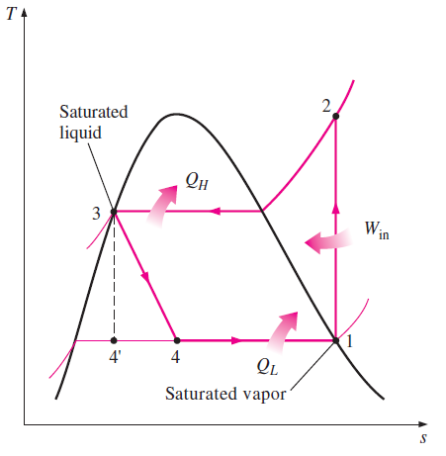
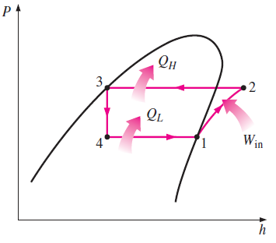


Ideal Vapor-Compression Refrigeration Cycle
Enthalpy, H= U+PV
Quiz 4：1

Slide 50
Homework 4：3
Refrigerant-134a enters the compressor of a refrigerator as superheated vapor at 0.14 MPa and -10°C at a rate of 0.12 kg/s, and it leaves at 0.7 MPa and 50°C. The refrigerant is cooled in the condenser to 24°C and 0.65 MPa, and it is throttled to 0.15 MPa. Disregarding any heat transfer and pressure drops in the connecting lines between the components, show the cycle on a T-s diagram with respect to saturation lines, and determine (a) the rate of heat removal from the refrigerated space and the power input to the compressor, (b) the isentropic efficiency of the compressor, and (c) the COP of the refrigerator.

Slide 51
13. Silent power generator and refrigerator

Slide 52
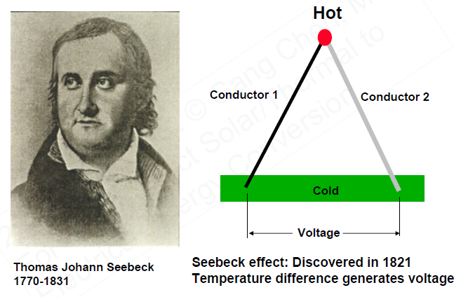
Seebeck Effect
Seebeck Effect, 1821
S, Seebeck coefficient
eg.
Cu: +1.8 μV/K
Bi₂Te₃:+200 μV/K
A
B
Thomas J. Seebeck
German physicist
(1770-1831)
An electrical voltage was produced
by heating the junction between two different electrical conductors (e.g. Cu and Fe)
Quiz 4：2

Slide 53
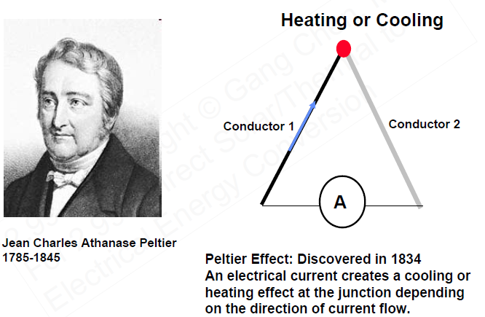
Peltier effect
Peltier effect, 1834
Cooling
Π, Peltier coefficient
N-type
I
P-type
Jean C.A.Peltier
French physicist
and watchmaker
(1775-1845)
Cooling was produced
at the junction of two dissimilar metals as a current pass it
Quiz 4：2

Slide 54
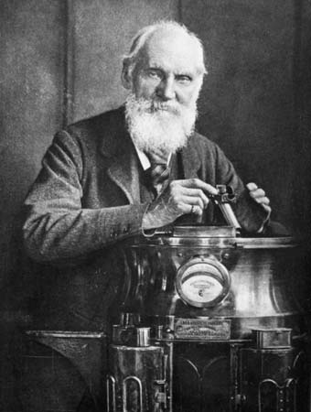
Thomson effect
Thomson effect, 1855
Heat release/absorption, q
β, Thomson coefficient
T_{cold}
T_{hot}
Current, I
Evaluation of heat when electric current passes through a single material that has a temperature difference along its length
William Thomson
1st Baron Kelvin
British physicist
(1824-1907)
Kelvin Relation
英国皇家“开尔文公爵”
* He is widely known for determining the correct value of absolute zero as approximately -273.15 Celsius.

Slide 55
Efficiency of TEG-updated
Efficiency of TEG
Set m=R_{L}/R
Figure of merit
Home work： finishing the derivation of η_{max} for a thermoelectric generator, and thinking about whether the Joule heat term in the Qc could be less than ½ I²R,
if possible how to achieve it, if not why?

Slide 56


Efficiency of TEC
Warm
Environment, Th
Q_{h}
p
n
Q_{c}
Refrigerator
Space, Tc
I
W
COP of TEC

Slide 57
13. Gibbs Free Energy
Chapter 5：
Introduction to the thermodynamics of materials,
6th edition, by David R. Gaskell, Talor & Francis Press, 2018

Slide 58
Thermodynamics free energy
Thermodynamic free energy,
the energy in a physical system that can be converted to do work
Helmholtz Free Energy A, or F
----the energy that can be converted into work at a constant T and V
Gibbs Free Energy G,
----the energy that can be converted into work at a constant T and P
throughout the system

Slide 59
Differential of the state functions
For a incremental change in the state of a closed system

Slide 60
Differential equations of the state functions
Helmholtz Free Energy
Gibbs Free Energy
Thermodynamic state variable: U, H, A, G
Thermodynamic state variable: T, P, V, S

Slide 61
14. Thermodynamic Relations
Chapter 5：
Introduction to the thermodynamics of materials,
6th edition, by David R. Gaskell, Talor & Francis Press, 2018

Slide 62
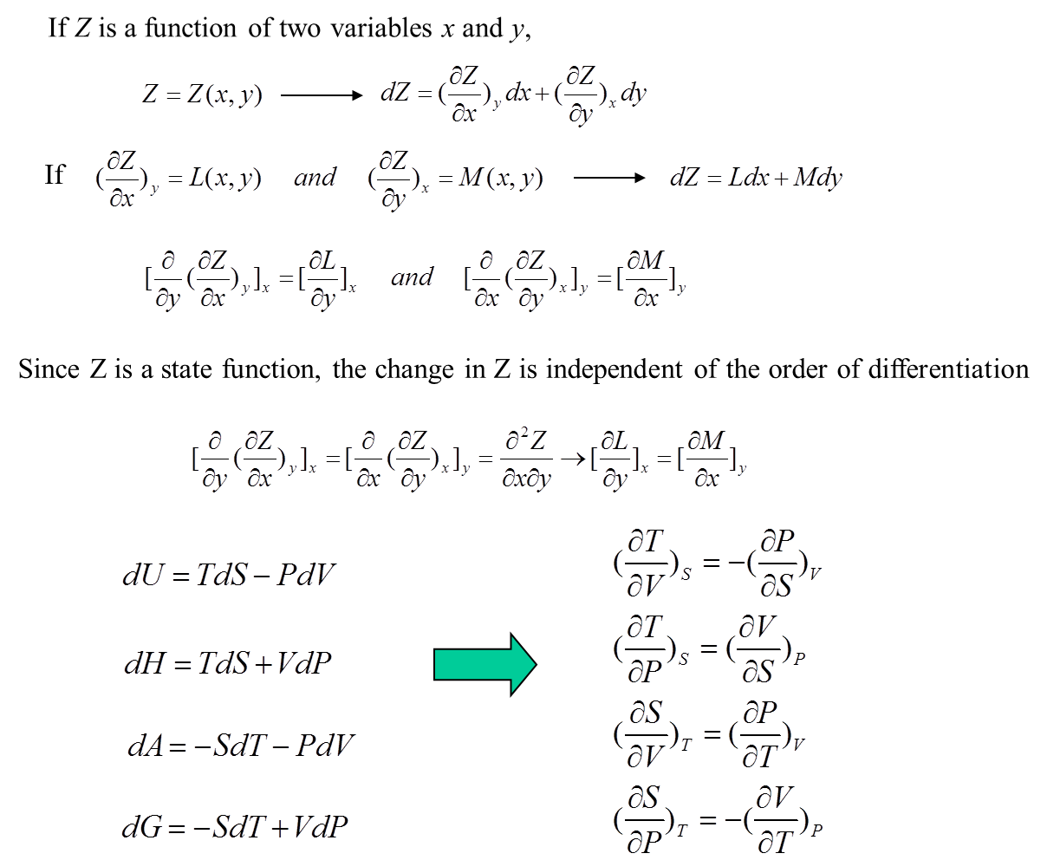
Thermodynamics square
Quiz 4：3
Extensive
parameter
Intensive
parameter
V
A
T
V
T
U
G
S
P
S
P
S
P
H
V
S
P
T
P
T

Slide 63
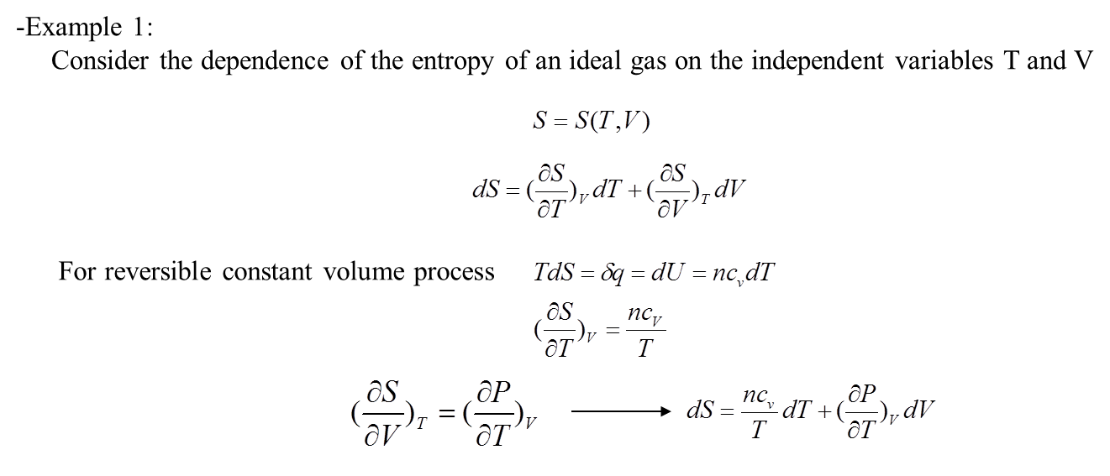
Application: 1st TdS equation
α: coefficient of thermal expansion
β_{T}: coefficient of isothermal compression
Notes:
有更正

Slide 64
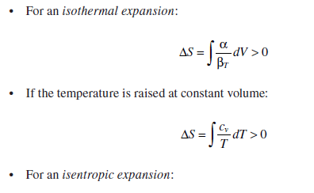
1st TdS equation
Quiz 4：4
1st TdS equation

Slide 65
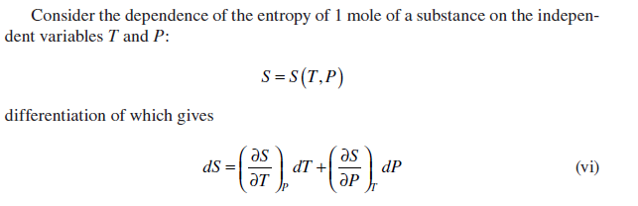

2nd TdS equation
For reversible constant pressure :
α: coefficient of thermal expansion
β_{T}: coefficient of isothermal compression

Slide 66


2nd TdS equation
For the 1 mol idea gas
Apply Maxwell relationship

Slide 67
Elastic, Magnetic, electric contribution to the free energy
From first law
P-V work
Chemical work
Elastic work
σ and ε are the strain and stress
Magnetic work
H and B are the magnetic field
strength and induction
Electric work
E and D are the electric filed
strength and displacement
Ref. ZiKui Liu and Yi Wang,
computation of thermodynamics of materials，Cambridge Press, 2016

Slide 68
15. The general strategy for the derivation
of thermodynamic relation
Ref. Robert Dehoff, CRC Press, (2006)
Thermodynamics in Materials Science： Chapter 4

Slide 69
Energy function expressed of T and P
Determinant form:

Slide 70
Related the entropy of system to T and V
1. Identify the variable: S=S(T, V)
2. Write the differential form : dS=MdT+NdV
3. Convert dV:
4. Collect item
5. Obtain S=S(T, P) form the table
6. Compare the coefficient
S=S(T, V)
7. Solve the equation for M and N

Slide 71
Related the entropy of system to P and V
1. Identify the variable: S=S(P, V)
2. Write the differential form : dS=MdP+NdV
3. Convert dV:
4. Collect item
5. Obtain S=S(T, P) form the table
6. Compare the coefficient
7. Solve the equation for M and N
S=S(P, V)

Slide 72
Applied to idea gas
The equation of idea gas
For 1mol gas, i.e. n=1

Slide 73
16. Boltzmann Equation
Chapter 4
Introduction of Thermodynamics, /6th Edition, CRC Press, 2018

Slide 74
Most Probable Distribution
Let’s say we have a system of volume V, internal energy, U and temperature T, consists of n particles.
The particles can be atoms, molecules, which are structurally identical.
These particles are distributed in i energy levels (quantum theory)
Combinatorics
Energy level
e₀
e₁
e₂
……..
e_{i}
Distribution 1
Distribution 2
# of particles
n₀
n₁
n₂
……..
n_{i}
# of particles
n’₀
n’₁
n’₂
……..
n’_{i}
∑n_{i} = n, and ∑e_{i}n_{i} = U
The number of combinations:
The number of total combination:

Slide 75

Most Probable Distribution
The earlier example:
The number of arrangement

Slide 76
Find Most Probable Distribution
Find Most Probable Distribution
=Find set of n_{i}, to maximize Ω_{i} = n!/(n₁!n₂!..n_{i}!)
Any interchange of particles
Stirling’s approximation: when X is very large: ln(X!) ≈ XlnX -X
n is constant → δnlnn=0
If Ω has the maximum possible value then a small rearrangement of particles among the energy levels will not alter the value of Ω or of ln Ω

Slide 77
Find Most Probable Distribution
β is the constant with the units of reciprocal energy
Α is the dimensionless constant
Partition function

Slide 78

Boltzmann’s distribution function
Boltzmann’s distribution function
k_{B} is the Boltzmann constant
Schematic representation of the most probable distribution of particles among the quantized energy levels.

Slide 79
Temperature Effect
Higher temperature, higher energy levels become more populated, so the U increases

Slide 80


Boltzmann Equation
The system of n particles and heat bath with fixed U, V and n are in thermal equilibrium
Now let small amount of heat flow to the system, the Ω will change:
δq = dU, constant volume:
dS = δq/T
Boltzmann
equation
Entropy: S
Ludwig Boltzmann
Number of arrangement: Ω
1844-1906

Slide 81
Configurational Entropy
A + B (unmixed) → A + B (mixed) at constant U, V and n
(state 1) (state 2)
Total mix
Before mix

Slide 82

Application：elasto-coloric
Rapid stretching or unstretching of a wide rubber band is nearly isentropic/ adiabatic process
The stretching decreases the configurational entropy S_{conf} (molecular structure becomes more ordered)
the stretching is isentropic, then the thermal/vibrational entropy S_{th} increase to compensate for the decrease of S_{conf}.
the heat generated by stretching is dissipated
T should decrease as a result of rapid unstretching

Slide 83

Application：the vacancy concentration
Considering the formation energy of a vacancy: ε_{V}
The increase entropy equivalent to arrange N atoms and n vacancies on N+n lattice site:

Slide 84
Homework 7：2
Considering the formation energy of a vacancy in a metal is ε_{v},
(1) For 1 mole of the metal, if the fraction of the vacancy is x at% (atom fraction), please calculate the configurational entropy.
(2) If x = 1 at%, please calculated the ε_{v} at 27℃ in unit eV, and formation enthalpy in the unit J/mol.
(3) Please explain some strategies to reduce the concentration of vacancies from the view point of thermodynamics.

Slide 85
21. Statistic interpret of Heat capacity

Slide 86


Equipartition of energy
each degree of freedom would have an average energy in the amount of k_{B}T/2
The possible degree of freedom include: translation, rotation and vibration
Internal energy and specific heat
The monatomic gas
The diatomic gas
More complicate molecular
N₂O: f=13
H₂O: f=12
Open question

Slide 87


Einstein model
Frequency
Γ
Wave Vector
Einstein model, 1907
A crystal containing n atoms, each atom behaves as a harmonic oscillator vibrating independently about its lattice point.
As the behavior of each oscillator is not influenced by the behavior of its neighbors, each oscillator vibrates with a single fixed frequency v
A system of such oscillators is called an Einstein crystal.

Slide 88
Einstein model
Defining hv/k=θ_{E}, where θ_{E} is the Einstein characteristic temperature,
n equal to Avogadro’s number N_{a}, nk_{B} =R

Slide 89
Debye model of c_{V}
Debye model, 1912
Einstein’s assumption:
the assumption the oscillators vibrate with a single frequency
Debye’s modification:
the oscillators vibrate with in a rang of frequency

Slide 90


Debye model
Phonon
velocity
Angular
frequency
Frequency
Wave
vector
Γ
Wave Vector
Peter Debye
1884-1966
linear dispersion relationship
Cut-off frequency: ω_{D}
Cut-off frequency: k_{D}
The Nobel Prize in Chemistry 1936
Notes:
1936年度的德拜（Peter Debye）因发展X-射线衍射而获奖。德拜是大牌物理学家，其1925年底嘟哝的一句“谈论波动总得有个波动方程吧”导致薛定谔老师上山写出了量子力学的基本方程；
1998年度的柯恩（Walter Kohn）因发展密度泛函理论获奖，1977年度的普利高津（Ilya Prigogine）因发展非平衡态热力学获奖

Slide 91

Debye model of c_{V}
The materials with heavier atom has smaller θ_{D}
Figure 6.3 The constant-volume molar heat capacities of several solid elements. The curves are the Debye equation with the indicated values of θD.

Slide 92
Homework 7：3
It is well-known that the heat capacity follows the Dulong-Petit law, but it significantly deviates from the value of 3R. Figure below shows the temperature dependent heat capacity, c_{v}, of four solid elements.
(1) Please write the approximate relationship of c_{v} and T, as T is close to 0K.
(2) Please tell the differences between Einstein model and Debye model of cv, you can explain with schematic figure. Which model is better at low temperatures?
(3) Use the relation to distinguish and mark the two curves between Ag (θ_{D} = 213) and Al (θ_{D} = 385) in the image below.

Slide 93




Pei Model:
modify the linear dispersion assumption
YanZhong Pei
Tongji University
The phonon dispersion relationship is
a sine-type rather than a linear type

Slide 94
Pei Model:
modify the linear dispersion assumption
Pei’s mode covering both the features
of Einstien’s model and Debye’s mode

Slide 95

Estimation of κ_{min}
David G. Cahill
The relax time is equal to the half of the vibration circle
Lattice thermal conductivity reach the minimum

Slide 96
Estimation of κ_{min}
Frequency
Sine dispersion
Γ
Wave Vector
Frequency
Linear dispersion
Γ
Wave Vector
Pei’s mode correct the linear dispersion approximation
And give a lower κ_{min}
I would like to thank Prof. Pei to provide the slides for this lecture.

Slide 97

The heat capacity of matter at low temperature
1. Lattice heat capacity
2. Electronic heat capacity
3. Magnetic heat capacity
4. Heat capacity anomalies
1800 Black first proposed the concept of heat capacity
1819 Dulong-Petit Law
1907 Einstein Model
1912 Debye Model
1928 Electronic heat capacity - Sommerfeld
1963 Rosenberg proposed the Schottky anomaly of heat capacity in solids
1980 Magnetic heat capacity - Sinha and Kumar
1992 Elliott discovered the Boson peak anomaly in heat capacity
2010-2020 Calorimetry, New model and Application
Notes:
从研究历史也可以发现固体的比热大致包含以下几类：晶体比热、电子比热、磁比热、异常比热
1800布莱克首次提出比热的概念
1819杜隆泊替定律
1831纽曼-科普定律进一步发展了杜隆泊替定律
1907年随着低温技术的发展，随着温度的降低，比热迅速减小，爱因斯坦基于量子理论提出了爱因斯坦模型
1912年，随着温度的进一步降低，在20K以下，爱因斯坦模型和实验结果差别较大，德拜提出德拜模型
1928年索末菲提出自由电子气模型，并由此推导出了电子比热
1963年，Rosenberg提出了固体中的肖特基异常比热
1980年，Sinha and Kumar在前人的基础上系统的提出了各种磁作用的比热
1992年，Elliott首次发现了波色峰
2010-2020进入21世纪，比热的研究主要集中在量热学、新型比热拟合模型的开发、比热在物理现象解析中的应用

Slide 98







Electronic heat capacity
When a gas consisting of N electrons (N is assumed to be very large) is in thermal equilibrium the probability that a particular energy level is occupied is given by the Fermi-Dirac distribution function.
$$f\left(ε\right)=\frac{1}{e^{{\left(ε−μ\right)}/{k_{B}T}}+1}$$
$η\left(ε_{F}\right)$ is the density of states at the Fermi level.
Electronic heat capacity
$$C_{e}={\left(k_{B}T\right)}^{2}\frac{η\left(ε_{F}\right)}{T}2\int_{0}^{∞}{\frac{x^{2}e^{x}}{\left(e^{x}+1\right)}}dx$$
The numerical value of the above integral is ${π^{2}}/6$ and hence:
$$C_{e}=\frac{1}{3}π^{2}k_{B}^{2}η\left(ε_{F}\right)T=γT$$

Slide 99



Fermi-Dirac distribution function
$$f\left(ε\right)=\frac{1}{e^{{\left(ε−μ\right)}/{k_{B}T}}+1}$$
Fermions are the raw materials from which matter is made. (Electrons, quarks)
Bose-Einstein distribution function
$$f\left(ε\right)=\frac{1}{e^{{\left(ε−μ\right)}/{k_{B}T}}−1}$$
Bosons are particles that transmit forces. (Photons, mesons, phonons)

Slide 100
22. Engineering considering of heat capacity

Slide 101


The Empirical representation of heat capacity
The experimentally measured variation of the constant-pressure molar heat capacity of a material with temperature is normally fitted to an expression of the form

Slide 102



Temperature dependent C_{p}
Regular materials
Cu₂Se
500K
700K
900K
1100K
Acta Materialia，2015

